Slide 1
Introduction to Multi-Layer Perception Model
- Download MNIST data.
- Intro to MLP.
Jack Wu

Slide 2
Download MNIST Data
In [1]: from keras.datasets import mnist
For Windows:
You should see a file called mnist.npz under C:\Users\YOUR_USERNAME\.keras\dataset
For Linux/macOS:
You should see a file called mnist.pkl.gz under ~/.keras/datasets/mnist.pkl.gz

Slide 3
Multi-Perception Model.
A brief introduction.

Slide 4
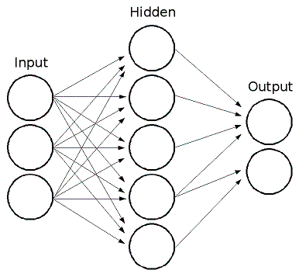
What is MLP?
“Feedforward” artificial neural network.
Feed(Input) + Forward(Input→Hidden→Output).
So MLP consists at least three layers of nodes.
This image below shows a MLP model with three layers.
Image Credit: https://docs.opencv.org/3.0-beta/_images/mlp.png

Slide 5
What are Nodes?
Think of it like a “Neuron”.
Each node uses a non-linear activation function.
For example, we can use the ReLU function for the hidden layers.
Image Credit: https://docs.opencv.org/3.0-beta/_images/mlp.png

Slide 6
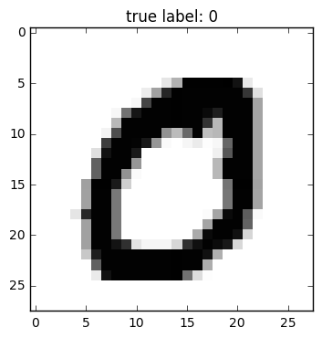
About MNIST Dataset
For what we are going to explain, we will take the MNIST images for example.
The MNIST dataset contains many 28x28 images that has labels 0-9.
i.e. Each image has 28*28 = 784 pixels.
Image Credit and Read More: https://rasbt.github.io/mlxtend/user_guide/data/mnist_data/

Slide 7
What’s the MLP structure?
x0
x1
…
x784
Input Layer:
784 Input Nodes.
(28*28=784 pixels)
h0
h1
…
h256
Hidden Layer:
256 Nodes.
y0
y1
…
y9
Output Layer:
10 output nodes.
(Numbers 0-9)

Slide 8
Activation Function and Training
- Intro to ReLU and SoftMax.
- Intro to Supervised Learning and Backpropagation.
Jack Wu

Slide 9
Activation Function
x0
x1
…
x784
Input Layer(x)
h1 = ReLU(x*w1 + b1)
h0
h1
…
h256
Hidden Layer(h)
y = SoftMax(h1*w2 + b2)
y0
y1
…
y9
Output Layer(y)

Slide 10
The ReLU Activation Function h1 = ReLU(x*w1 + b1)
x: x is the input that receives data. There are 784 inputs that receives data.
h1: h1 is the hidden layer (hidden layer 1) and it contains 256 hidden nodes selected by human.
w1: w1 is the weight. It simulates the axon that connects the input nodes to the hidden nodes. Basically, it defines how important one node is in respect to other nodes. In order to connect all the nodes between the two layers, w1 must be a 784x256 matrix to simulate all 784*256=200704 connections.
b1: b1 is the bias. It simulates the synapsis and it represents how active the neuron is to transmit signal. In this case because there are 256 nodes in the hidden layer, the bias is an array of size 256.
ReLU: Activation function. When the value of h1 is above threshold, the node activates and transmits data to the next node.

Slide 11
The SoftMax Activation Function y = SoftMax(h1*w2 + b2)
h1: h1 is the hidden nodes from the hidden layers. There are 256 hidden nodes.
y: y is the output and it contains 10 nodes representing 0-9.
w2: w2 is the weight. It simulates the axon that connects the hidden nodes to the output nodes. Basically, it defines how important one node is in respect to other nodes. In order to connect all the nodes between the two layers, w2 must be a 256x10 matrix to simulate all 256x10=2560 connections.
b2: b2 is the bias. It simulates the synapsis and it represents how active the neuron is to transmit signal. In this case because there are 10 nodes in the output layer, the bias is an array of size 10.
SoftMax: Activation function. When the value of y is above threshold, the node activates and makes a prediction.

Slide 12
Now. How to train a MLP model?
MLP utilizes a supervised learning technique called Backpropagation for training.

Slide 13
Supervised Learning
We will distinguish the differences between supervised and unsupervised learning.
Supervised Learning uses pre-labeled data. We can understand it as “Learning from mistake”.
Unsupervised Learning uses data without labels, and we can think of it as “Figure out the pattern”.

Slide 14
Backpropagation
Backpropagation is a common practice in modern machine learning model training.
We use backpropagation along with optimizers, like the most famous gradient decent optimizer.
Backpropagation is supervised learning, which means the data we input needs to have a “feature” and a “label”.
Like we stated before, backpropagation is basically “learning from mistakes”.

Slide 15
END

